Slide 1
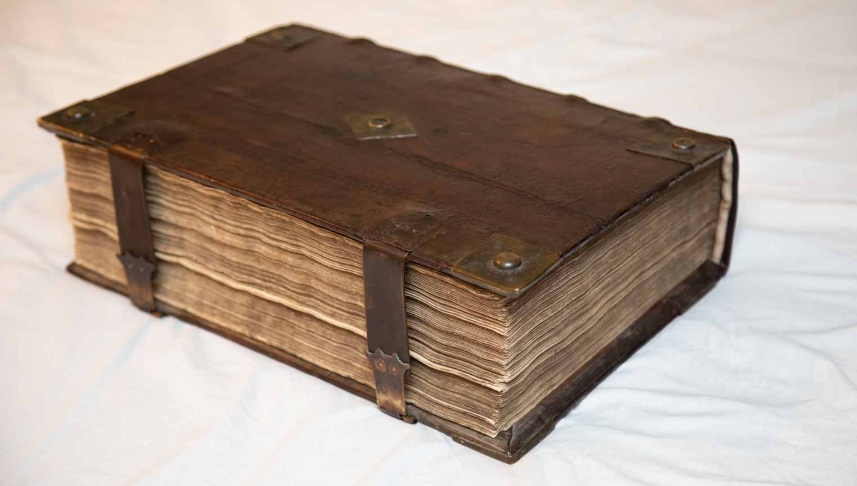
How We Got The Bible
God Spoke… lesson #1

Slide 2
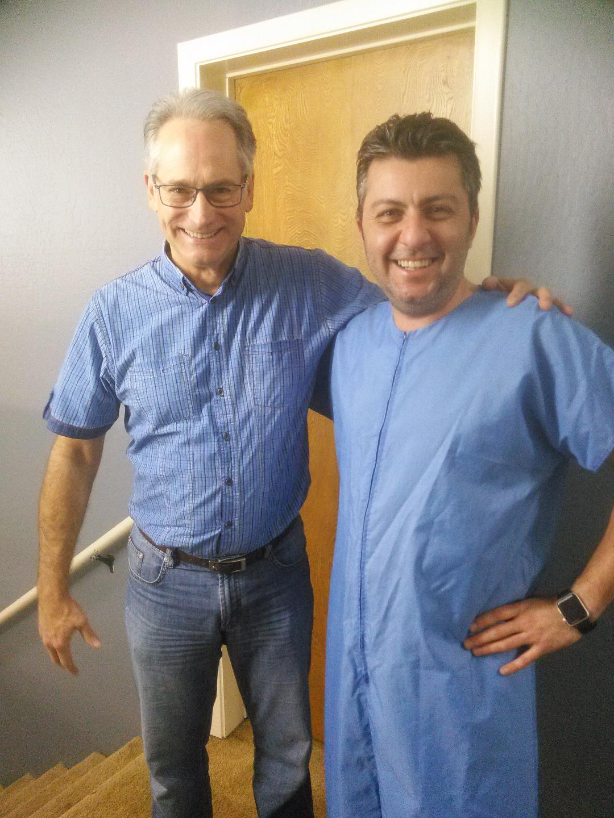

Slide 3
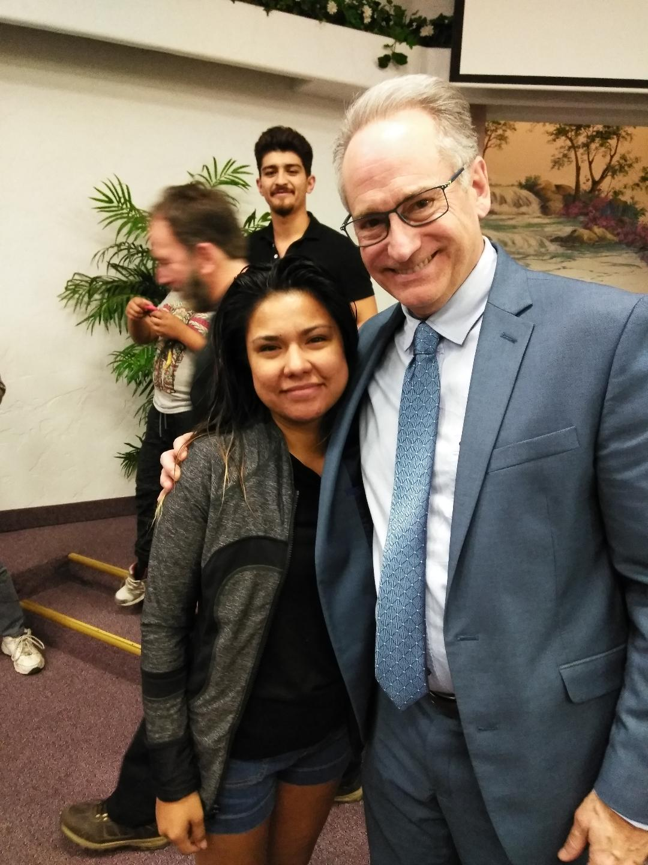

Slide 4
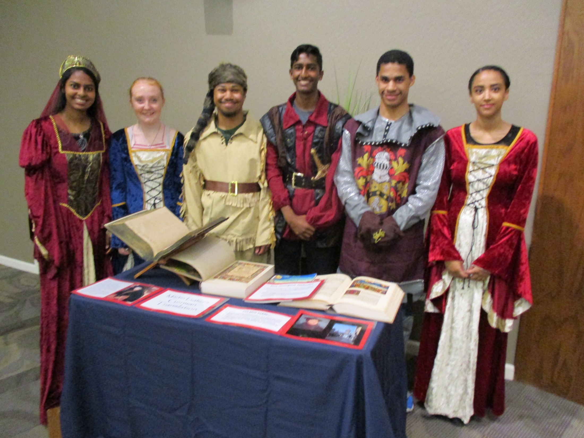

Slide 5
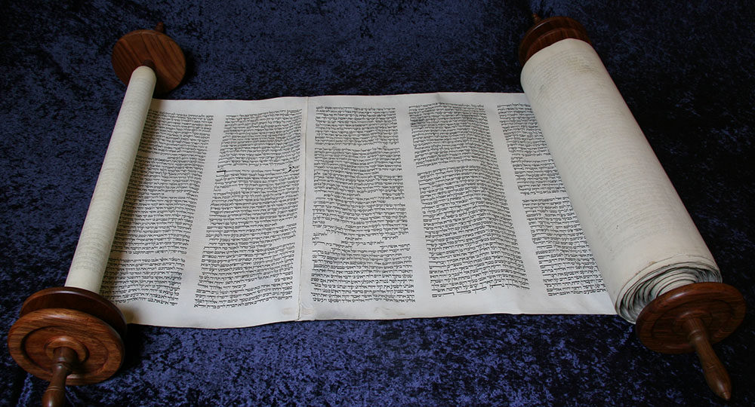
Psalm 119:130
“The unfolding of your words gives light;
it imparts understanding to the simple.”

Slide 6
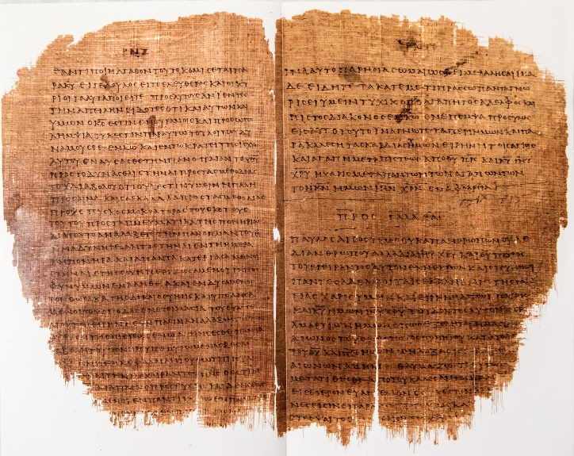

Slide 8
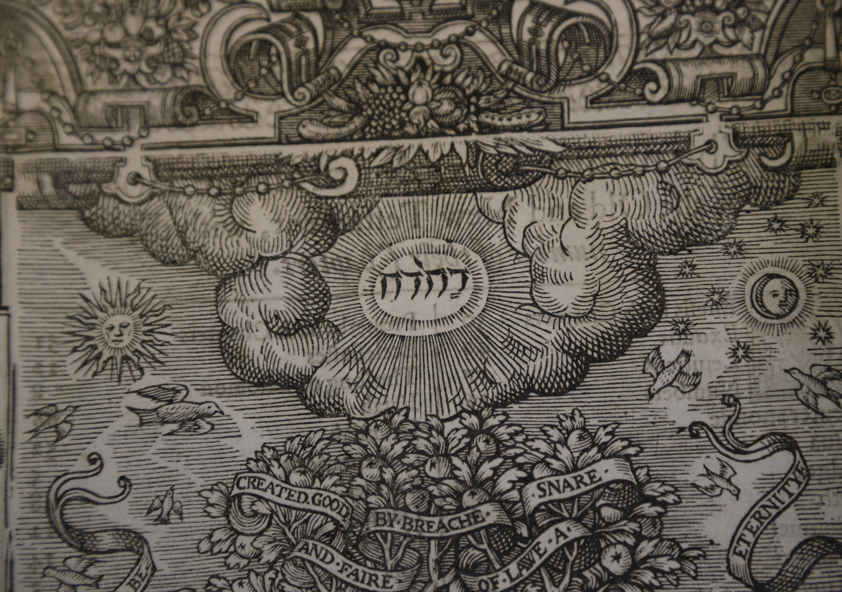

Slide 9
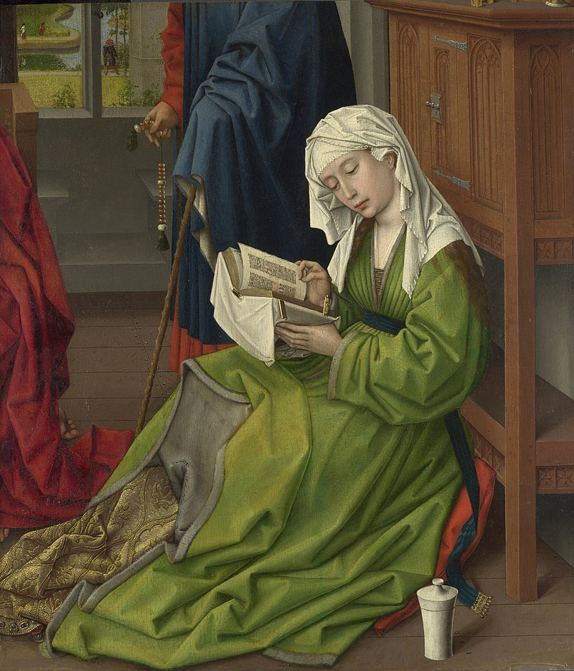

Slide 10
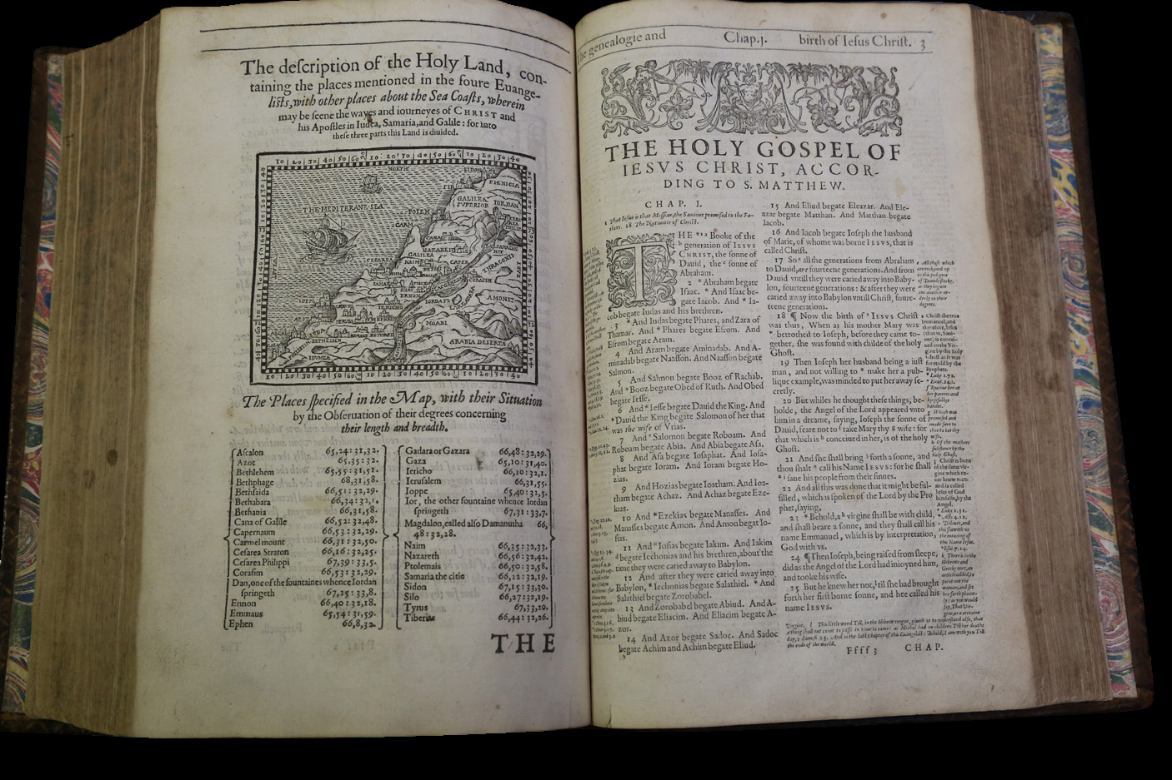

Slide 12
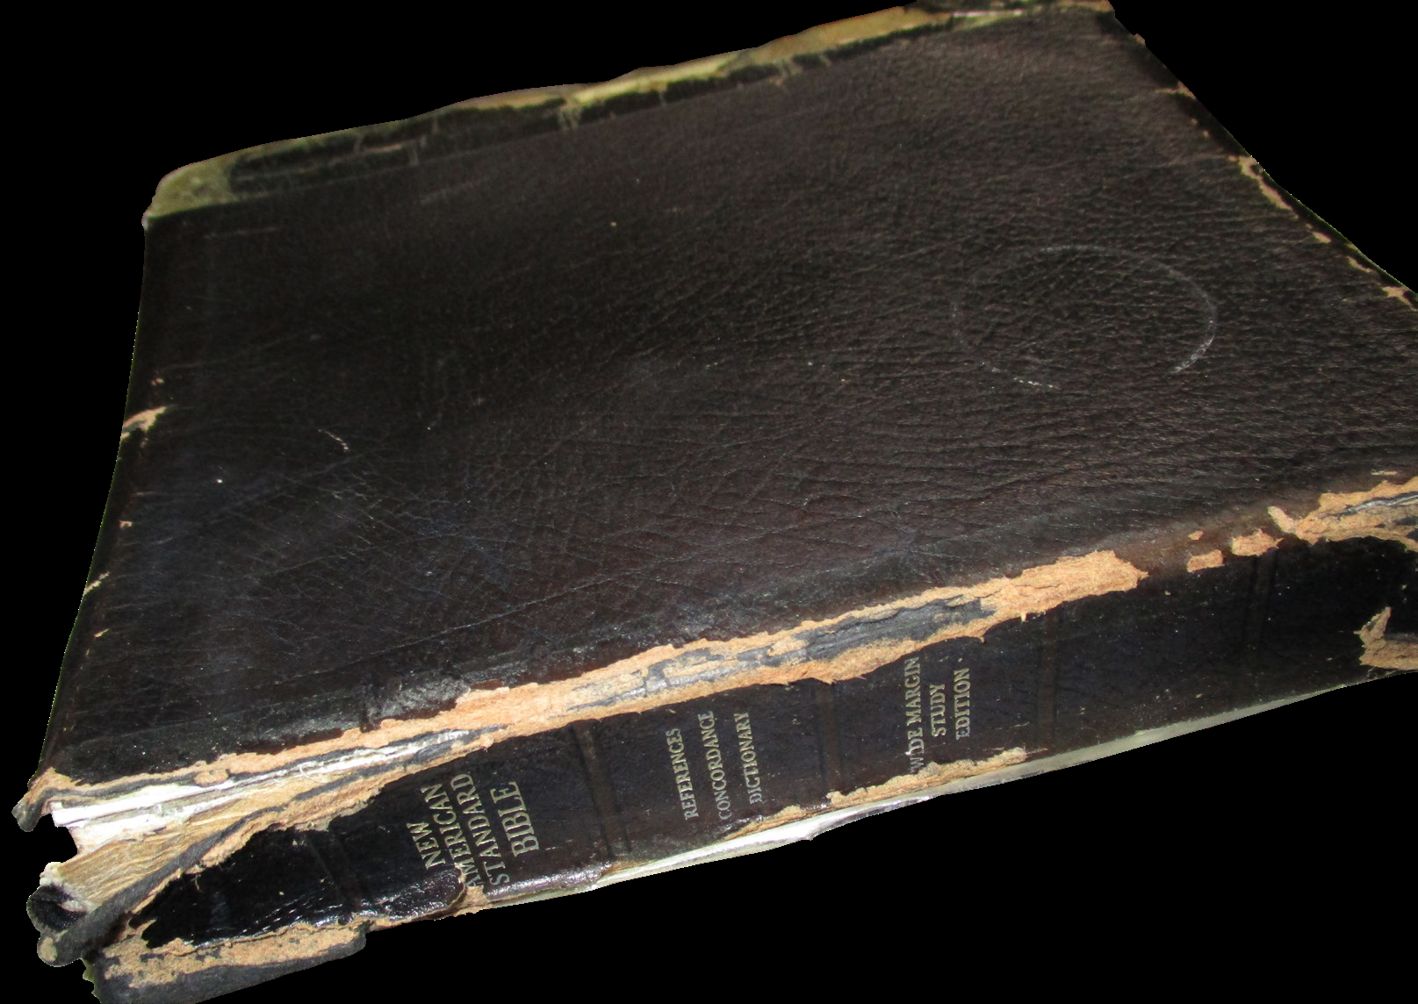

Slide 13
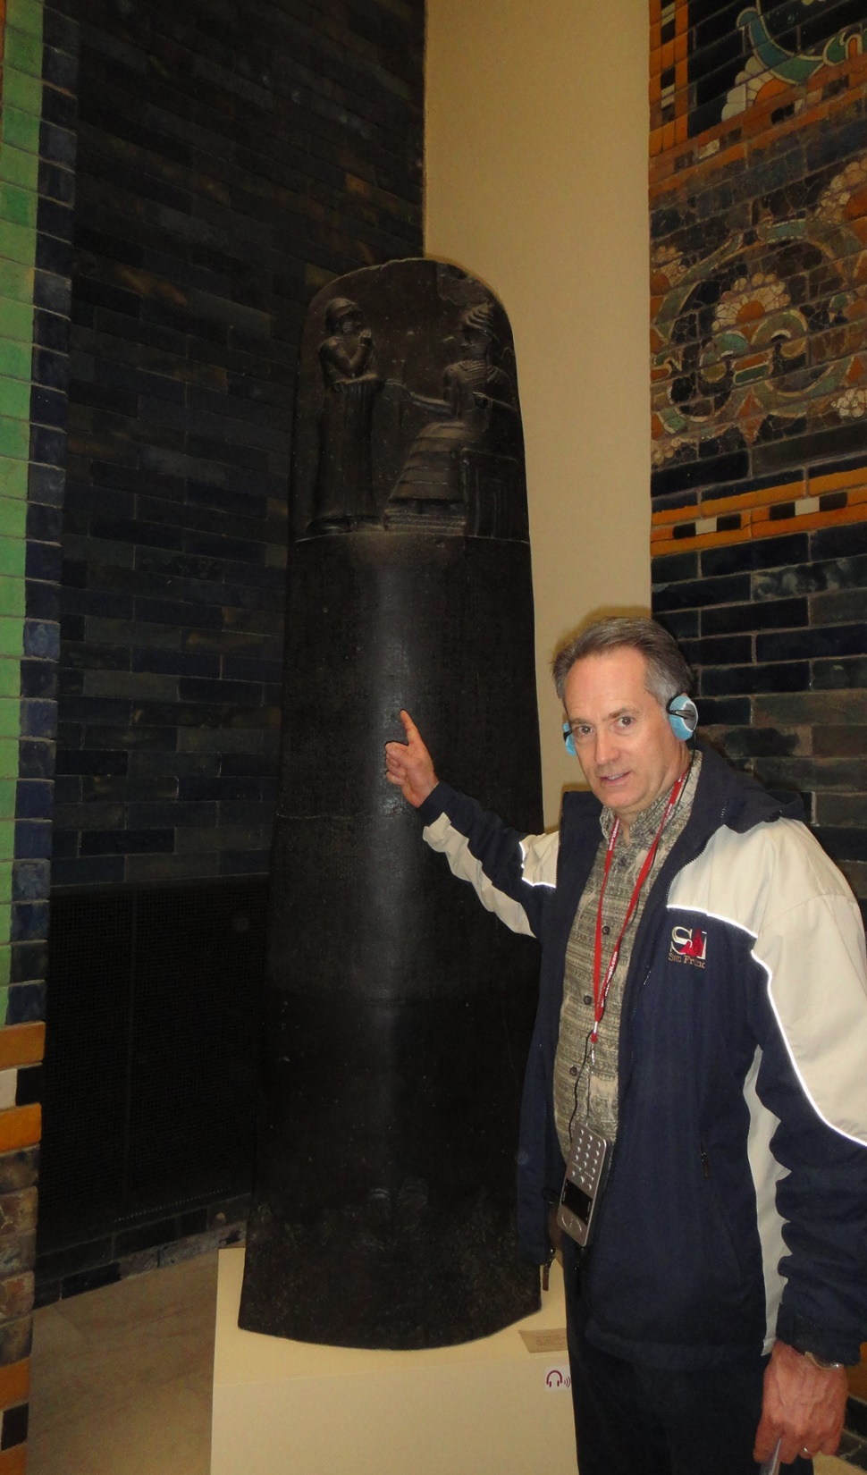

Slide 14
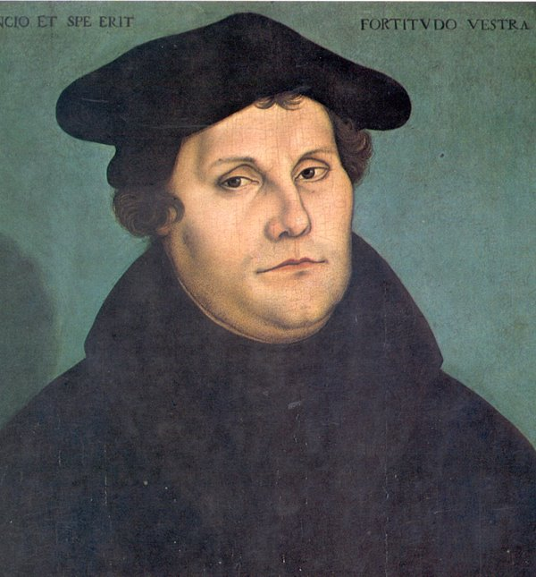

Slide 15
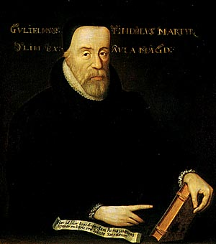

Slide 16
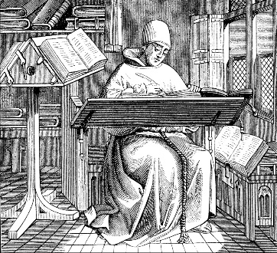
The Message of the Bible
The claim – “the Word of God”
Gen. 1:1; Jn. 7:16-17; 1 Thess. 2:13

Slide 17
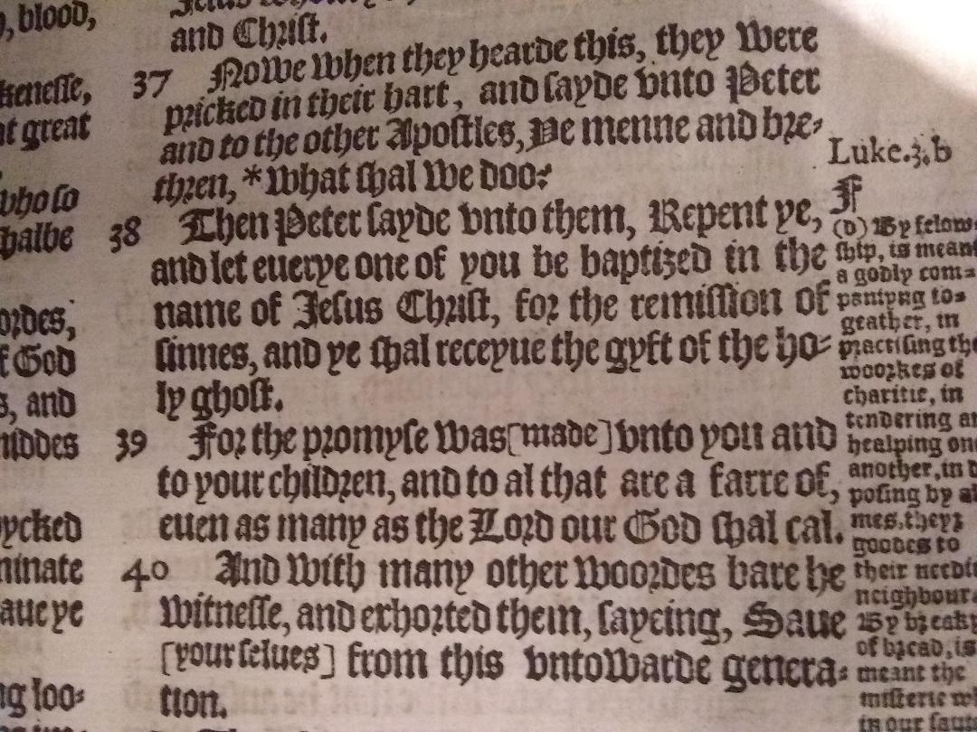

Slide 18
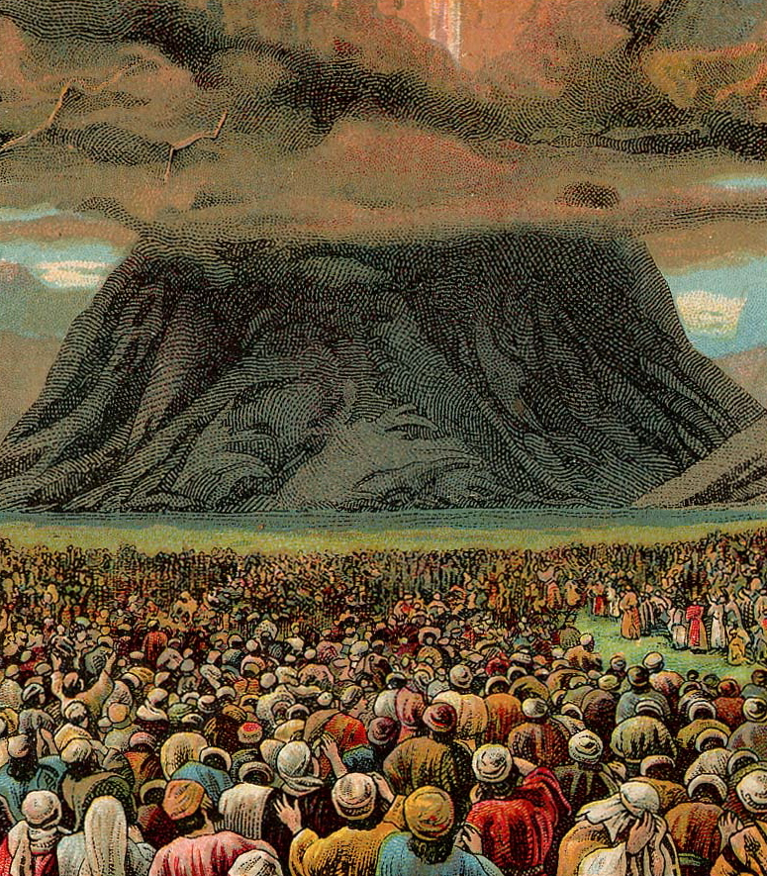

Slide 19
Process of Communication
Hebrews 1:1-2 – “Long ago, at many times and in many ways, God spoke to our fathers by the prophets, but in these last days he has spoken to us by his Son…”
God’s delivery system

Slide 20
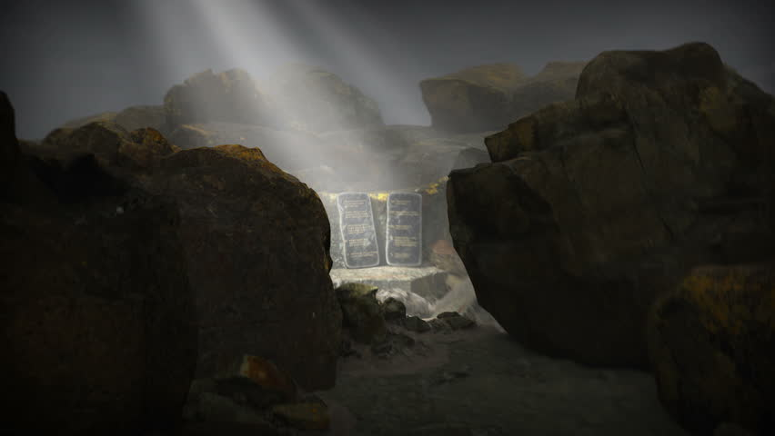

Slide 21
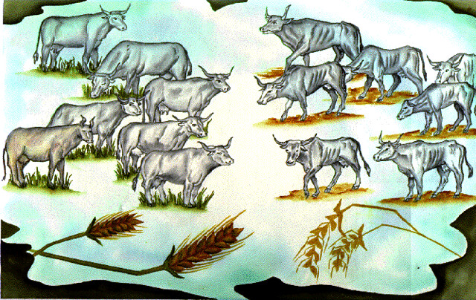

Slide 22
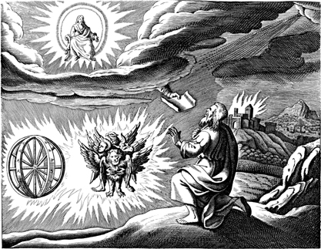

Slide 23
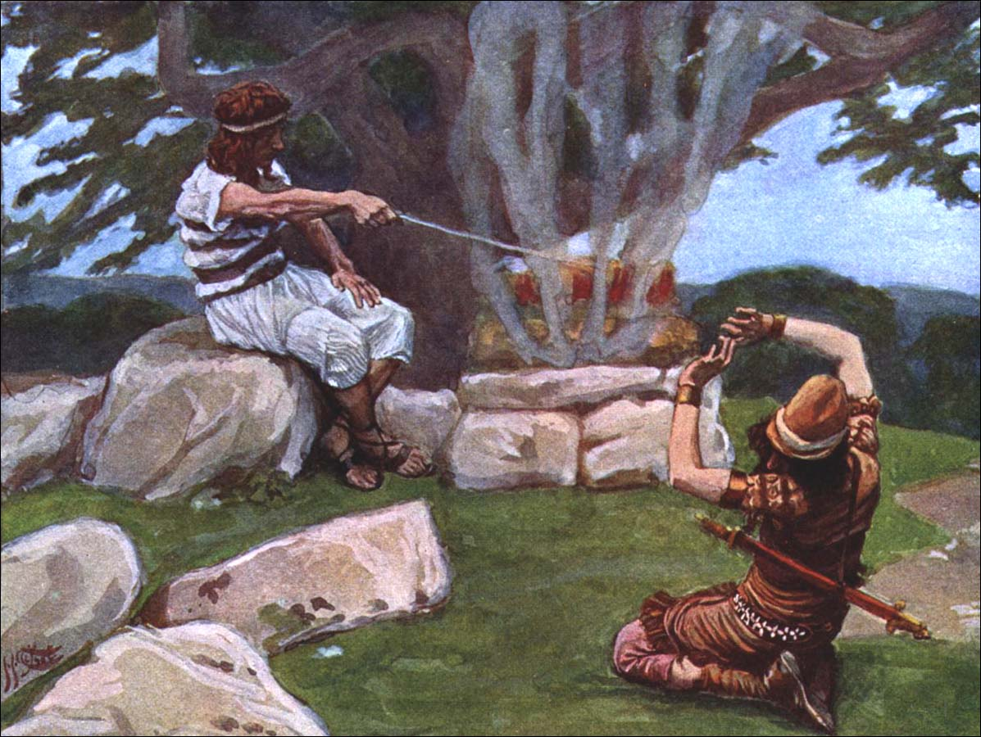

Slide 24
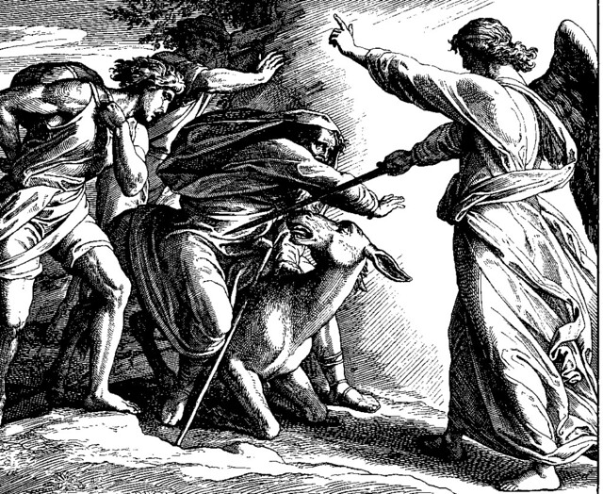

Slide 25
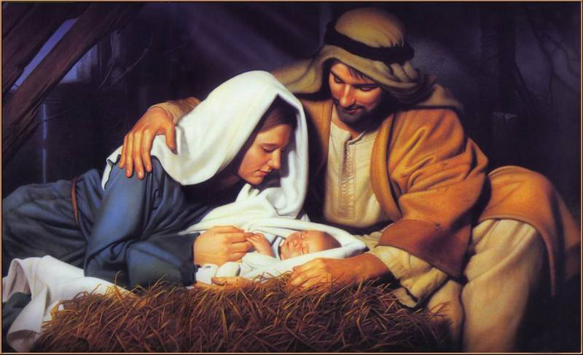
Cumulative
Galatians 4:4 – “But when the fullness of time had come, God sent forth his Son, born of woman, born under the law…”

Slide 26
Now at last fully revealed!
Eph. 3:8-9
“To me, though I am the very least of all the saints, this grace was given, to preach to the Gentiles the unsearchable riches of Christ,
and to bring to light for everyone what is the plan of the mystery hidden for ages in God who created all things.”

Slide 27
Complete
God
Jesus Christ
Holy Spirit
Apostles & Prophets
Written Word

Slide 28
Evidence
Claims
Signs, wonders, miracles
Predictive prophecy
Eyewitness testimony

Slide 29
Events / Original Circumstances
Signs of Authenticity or Red Flags of Counterfeit Hanky-Panky?
Historical reports or legends?
Authors of the Documents
Genuine vs. Forgeries?
Autograph Originals
Faithful transmission?
Existing Manuscripts
Legitimate process or bogus?
Recovered Text in Hebrew or Greek
Accurate?
Modern Translations

Slide 30
Things to Look For…
Sinister agenda?
Something to hide?
Hypocritical behavior?
Counterfeit tendencies?
--------------------------------------------
Honorable representation?
Transparency?
Genuine appeal to truth?
Actions consistent with words?

Slide 31
Organizing the Material
Luke 1:1-4
Jeremiah 36
Isaiah 8:16

Slide 32
Tests of Inclusion
Was it written by a prophet of God?
Was he confirmed by an act of God?
Does his message harmonize with prior revelations of God?
Does the message have the power of God?
Was it formally accepted by the people of God?

Slide 33
Concluding Observations
The “Word of God”
An outrageous claim… unless it happens to be true
Powerful evidence… integrity of transmission… a message with the ring of truth

